Slide 1

CAP 6317/4773: Social Media Mining
Lecture 19: Assortativity: Homophily and Influence
Raiyan Abdul Baten, Ph.D.
March 28, 2024

Slide 2
Recap

Slide 3
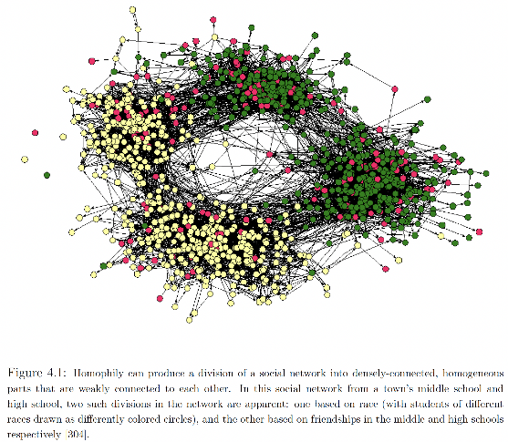
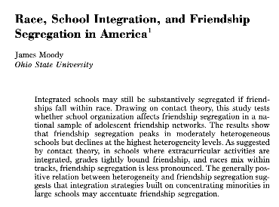

Slide 4
Assortativity
Similar nodes are connected to one another more often than dissimilar nodes.
Example: Friendship network
Similar behavior
Similar interests
Similar activities
Similar beliefs
Shared attributes such as language, age, gender, location etc.
Let’s ignore the underlying causal mechanisms for now, and analyze a network ‘snapshot’ for assortativity.

Slide 5
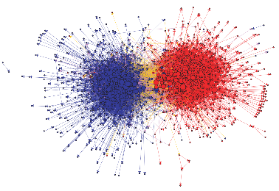
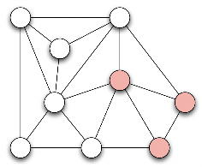
Modularity
Q = (Fraction of edges between nodes of the same type) -­ (Expected fraction of edges between nodes of the same type due to random chance)
Positive values: We have assortativity
Negative values: We have reverse assortativity

Slide 6


Modularity
Q = (Fraction of edges between nodes of the same type) -­ (Expected fraction of edges between nodes of the same type due to random chance)
Fraction of edges between nodes of the same type
=
=

Slide 7

Modularity
Q = (Fraction of edges between nodes of the same type) -­ (Expected fraction of edges between nodes of the same type due to random chance)
Expected fraction of edges between nodes of the same type due to random chance
=

Slide 8


Modularity
Q = (Fraction of edges between nodes of the same type) -­ (Expected fraction of edges between nodes of the same type due to random chance)
=
=

Slide 9
Reminder to self: Attendance

Slide 10
Readings for today’s class: Chapter 8

Slide 11
Assortativity

Slide 12


Modularity
Let’s normalize Q to get a score between -1 and 1

Slide 13

Modularity
Nothing fancy, just plugging in the values. We need to find the maximum of the denominator

Slide 14

Modularity
Perfect mixing is achieved when all edges fall between vertices of the same type. Hence, δ(t(v_{i} ) , t(v_{j} )) = 1 whenever A_{ij} = 1. The highlighted sum then becomes 2m.

Slide 15

Modularity

Slide 16

Modularity
Q_{normalized} is called the Assortativity Coefficient and goes from -1 to 1

Slide 17
Modularity
Q_{normalized} is called the Assortativity Coefficient and goes from -1 to 1
If ‘similar’ people have more edges between them than random chance: 0 < Q_{normalized} ≤ 1
If ‘dissimilar’ people have more edges between them than random chance: -1 ≤ Q_{normalized} < 0

Slide 18
Community Detection using Modularity: Spectral Modularity Maximization
Intuition: If we know the ‘types’ of the nodes, we can calculate Q. If there is assortativity, Q is positive.
Q = (edges inside the community) ­‐ (expected number of edges inside the community due to random chance) > 0

Slide 19
Community Detection using Modularity: Spectral Modularity Maximization
Intuition: If we know the ‘types’ of the nodes, we can calculate Q. If there is assortativity, Q is positive.
Q = (edges inside the community) ­‐ (expected number of edges inside the community due to random chance) > 0
But graph clustering is unsupervised: we do not know the ‘types’ of the nodes ahead of time.

Slide 20
Community Detection using Modularity: Spectral Modularity Maximization
Intuition: If we know the ‘types’ of the nodes, we can calculate Q. If there is assortativity, Q is positive.
Q = (edges inside the community) ­‐ (expected number of edges inside the community due to random chance) > 0
But graph clustering is unsupervised: we do not know the ‘types’ of the nodes ahead of time.
Let us flip the problem: try assigning ‘types’ to nodes, and find the assignments that maximize Q. Voila, those assigned types will be the cluster/community labels!

Slide 21
Community Detection using Modularity: Spectral Modularity Maximization
Q = (edges inside the community) ­‐ (expected number of edges inside the community)
Q =

Slide 22

Community Detection using Modularity: Spectral Modularity Maximization
Q = (edges inside the community) ­‐ (expected number of edges inside the community)
Define Modularity Matrix B_{ij} = A_{ij} -
Q =

Slide 23

Community Detection using Modularity: Spectral Modularity Maximization
For bisecting the graph, let us also define a type assignment vector, s, where

Slide 24

Community Detection using Modularity: Spectral Modularity Maximization
For bisecting the graph, let us also define a type assignment vector, s, where
Notice that the quantity = 1 if v_{i} and v_{j} are in the same type and 0 otherwise

Slide 25
Community Detection using Modularity: Spectral Modularity Maximization
For bisecting the graph, let us also define a type assignment vector, s, where
Notice that the quantity = 1 if v_{i} and v_{j} are in the same type and 0 otherwise
So, we have ) =

Slide 26
Community Detection using Modularity: Spectral Modularity Maximization
Q =

Slide 27

Community Detection using Modularity: Spectral Modularity Maximization
Q =
=

Slide 28

Community Detection using Modularity: Spectral Modularity Maximization
Q =
=
=

Slide 29

Community Detection using Modularity: Spectral Modularity Maximization
Q =
=
= [because Σ_{j}B_{ij} = Σ_{i}B_{ij} = 0]

Slide 30
Community Detection using Modularity: Spectral Modularity Maximization
Q =
=
= [because Σ_{j}B_{ij} = Σ_{i}B_{ij} = 0]
We want to find s that maximizes Q. This optimization problem is hard, but can be solved using relaxation methods and some Lagrange multiplier wizardry.

Slide 31



Community Detection using Modularity: Spectral Modularity Maximization
Differentiating Q and setting it to 0 leads us to

Slide 32
Community Detection using Modularity: Spectral Modularity Maximization
Differentiating Q and setting it to 0 leads us to
β is a single Lagrange multiplier: a scaler. We have the Eigenvector format!

Slide 33
Community Detection using Modularity: Spectral Modularity Maximization
Differentiating Q and setting it to 0 leads us to
So, we can solve for s by taking the Eigenvectors of B. This s will then maximize Q.
For maximum modularity Q, we should choose s to be the Eigenvector u₁ corresponding to the largest Eigenvalue of B.

Slide 34

Community Detection using Modularity: Spectral Modularity Maximization
Bisecting graphs then becomes extremely easy:
Take the Eigenvector u₁ associated with the largest Eigenvalue λ₁(B)
The signs of the entries of this Eigenvector tell you which node belongs to which cluster!

Slide 35
Unsupervised Learning Tasks on Graphs
Minimum Cut
Ratio Cut
Agglomerative Hierarchical Clustering in Graphs
Girvan-Newman Divisive Hierarchical Clustering Algorithm
Spectral Clustering
Spectral Modularity Maximization

Slide 36
Assortativity
Similar nodes are connected to one another more often than dissimilar nodes.
Example: Friendship network
Similar behavior
Similar interests
Similar activities
Similar beliefs
Shared attributes such as language, age, gender, location etc.
Now let us dive deeper into the underlying causal mechanisms!

Slide 37
Elements of Assortativity: Network-Intrinsic vs Extrinsic Contexts
Surrounding contexts can drive the formation of social links:
Network-Intrinsic context
Two people are introduced through a mutual friend (triadic closure)
Network-Extrinsic context
Two people become friends when they attend the same school

Slide 38
Elements of Assortativity: Homophily (selection) vs Influence
Selection: Individual characteristics drive the formation of links
The tendency of people to form friendships with others who are like them

Slide 39
Elements of Assortativity: Homophily (selection) vs Influence
Selection: Individual characteristics drive the formation of links
The tendency of people to form friendships with others who are like them
Often in response to immutable characteristics, e.g., race or ethnicity
The order of events is clear: a person’s attributes are determined at birth, and they play a role in how this person’s connections are formed over the course of his/her life

Slide 40
Elements of Assortativity: Homophily (selection) vs Influence
Selection: Individual characteristics drive the formation of links
The tendency of people to form friendships with others who are like them
Often in response to immutable characteristics, e.g., race or ethnicity
The order of events is clear: a person’s attributes are determined at birth, and they play a role in how this person’s connections are formed over the course of his/her life
Can happen in response to mutable characteristics as well, e.g., behaviors, activities, interests, beliefs
The order of events is not clear: Selection and Influence can happen back-and-forth

Slide 41
Elements of Assortativity: Homophily (selection) vs Influence
Selection: Individual characteristics drive the formation of links
The tendency of people to form friendships with others who are like them
Often in response to immutable characteristics, e.g., race or ethnicity
The order of events is clear: a person’s attributes are determined at birth, and they play a role in how this person’s connections are formed over the course of his/her life
Can happen in response to mutable characteristics as well, e.g., behaviors, activities, interests, beliefs
The order of events is not clear: Selection and Influence can happen back-and-forth
Social Influence: Existing links shape people’s mutable characteristics
People modify their behaviors to align more closely to their friends
Mutable characteristics become more similar due to social influence

Slide 42
Interplay between Selection and Influence: Drug Abuse
Selection: Teenagers seek out social circles composed of people like them
Influence: Peer pressure causes them to conform to behavioral patterns of their social circles

Slide 43
Interplay between Selection and Influence: Drug Abuse
Selection: Teenagers seek out social circles composed of people like them
Influence: Peer pressure causes them to conform to behavioral patterns of their social circles
Question: How do you decouple the two forces?

Slide 44
Interplay between Selection and Influence: Drug Abuse
Selection: Teenagers seek out social circles composed of people like them
Influence: Peer pressure causes them to conform to behavioral patterns of their social circles
Question: How do you decouple the two forces?
Answer: Longitudinal studies!

Slide 45
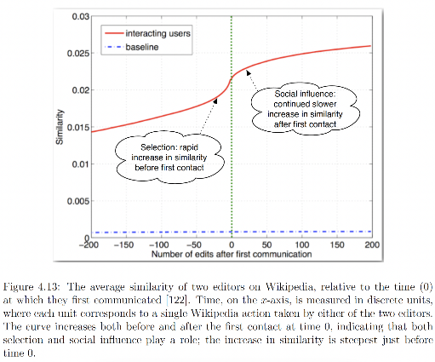
Interplay between Selection and Influence
Crandall, David, et al. "Feedback effects between similarity and social influence in online communities." Proceedings of the 14th ACM SIGKDD international conference on Knowledge discovery and data mining. 2008.

Slide 46
Interplay between Selection and Influence
Similarity between two editors = Num. of Wikipedia pages both editors edited / Num. of pages either editors edited
Crandall, David, et al. "Feedback effects between similarity and social influence in online communities." Proceedings of the 14th ACM SIGKDD international conference on Knowledge discovery and data mining. 2008.

Slide 47
Interplay between Selection and Influence
Baseline contains similarity between pairs of non-interacting editors. The similarity is far far lower!
Crandall, David, et al. "Feedback effects between similarity and social influence in online communities." Proceedings of the 14th ACM SIGKDD international conference on Knowledge discovery and data mining. 2008.

Slide 48
Designing Interventions: Drug Abuse

Slide 49
Interplay between Selection and Influence
Which effect is stronger: Selection or Influence?

Slide 50
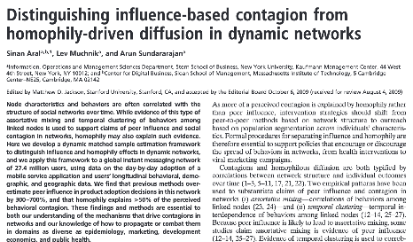
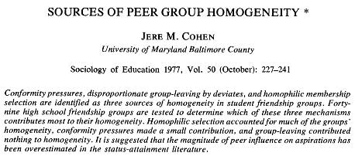
Interplay between Selection and Influence
Which effect is stronger: Selection or Influence?
In general, Selection >> Influence!

Slide 51
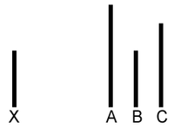
Solomon Asch’s Conformity Experiment
Yet, social influence remains very real!

Slide 52

Solomon Asch’s Conformity Experiment

Slide 53
Causally Separating Social Influence Effects
So far in the course, we’ve covered one way to make causal claims: Randomized Controlled Experiments
Now, we’ll cover two more methods for establishing causality:
Difference-in-Differences
Instrument Variable (IV) Regression

Slide 54
Difference in Differences
Is eating behavior contagious?
Selection: I choose friends who have a similar eating behavior
Influence: My friends influence my eating behavior
Which one is it?

Slide 55
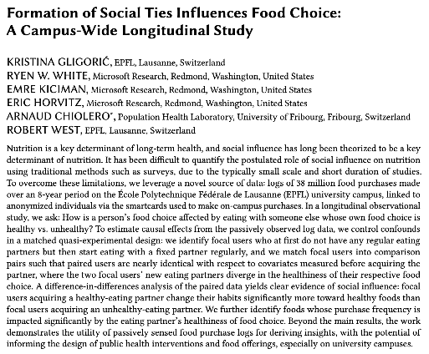

Slide 56
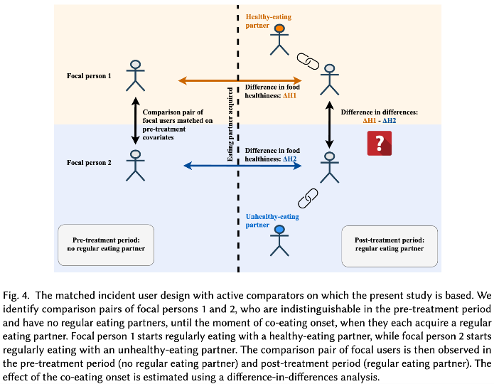
Notes:
where the food is purchased (what is the shop where the person most frequently buys food), when the food is purchased (what is the fraction of items occurring during lunchtime), what types of items are purchased (what fraction of purchased items are meals, and what is their estimated healthiness), and how often the person purchases food on campus (number of transactions). We measure these confounding covariates up to time 𝑡0

Slide 57
Matched Incident User Design: Matching is done on where, when, what, and frequency of people’s food purchasing behavior
Notes:
where the food is purchased (what is the shop where the person most frequently buys food), when the food is purchased (what is the fraction of items occurring during lunchtime), what types of items are purchased (what fraction of purchased items are meals, and what is their estimated healthiness), and how often the person purchases food on campus (number of transactions). We measure these confounding covariates up to time 𝑡0

Slide 58
You are my ‘frequent eating partner’ if we both purchase food within 1 minute of each other with no other customer between us, and this pattern happens at least 10 times
Notes:
where the food is purchased (what is the shop where the person most frequently buys food), when the food is purchased (what is the fraction of items occurring during lunchtime), what types of items are purchased (what fraction of purchased items are meals, and what is their estimated healthiness), and how often the person purchases food on campus (number of transactions). We measure these confounding covariates up to time 𝑡0

Slide 59
The first occurrence of proximity in the dataset indicates the onset of the co-eating
Notes:
where the food is purchased (what is the shop where the person most frequently buys food), when the food is purchased (what is the fraction of items occurring during lunchtime), what types of items are purchased (what fraction of purchased items are meals, and what is their estimated healthiness), and how often the person purchases food on campus (number of transactions). We measure these confounding covariates up to time 𝑡0

Slide 60
∆H1 and ∆H2 are pulled toward opposite directions
Notes:
where the food is purchased (what is the shop where the person most frequently buys food), when the food is purchased (what is the fraction of items occurring during lunchtime), what types of items are purchased (what fraction of purchased items are meals, and what is their estimated healthiness), and how often the person purchases food on campus (number of transactions). We measure these confounding covariates up to time 𝑡0

Slide 61
(∆H1 - ∆H2) being significantly > 0 would causally prove that having a healthy-eating partner helps improve people’s eating behavior
Notes:
where the food is purchased (what is the shop where the person most frequently buys food), when the food is purchased (what is the fraction of items occurring during lunchtime), what types of items are purchased (what fraction of purchased items are meals, and what is their estimated healthiness), and how often the person purchases food on campus (number of transactions). We measure these confounding covariates up to time 𝑡0

Slide 62
Instrument Variable (IV) Regression
Borrowed from Econometrics
Uses a 2-stage-least-squares (2SLS) approach to infer causality

Slide 63

Are exercise behaviors contagious?

Slide 64

Are exercise behaviors contagious?

Slide 65

Are exercise behaviors contagious?

Slide 66
Are exercise behaviors contagious?
My friend runs
I run

Slide 67
Not so fast…
I befriend a runner
I WANT TO start running

Slide 68
Not so fast…
Apple watch introduces a cool feature
I run
My friend runs

Slide 69
Not so fast…
Apple watch introduces a cool feature
I run
My friend runs

Slide 70
Are our soldiers paid fairly?
I go to the Vietnam war
My life earning suffers

Slide 71
Are our soldiers paid fairly?
Limited opportunities for growth
My life earning suffers
I go to the Vietnam war

Slide 72
Are our soldiers paid fairly?
Limited opportunities for growth
My life earning suffers
I go to the Vietnam war

Slide 73
Introducing the Instrument Variable
Limited opportunities for growth
Draft lottery
My life earning suffers
I go to the Vietnam war

Slide 74
Introducing the Instrument Variable
Limited opportunities for growth
Draft lottery
My life earning suffers
I go to the Vietnam war

Slide 75
Introducing the Instrument Variable
Limited opportunities for growth
Draft lottery
My life earning suffers
I go to the Vietnam war
“Instrument variable”

Slide 76
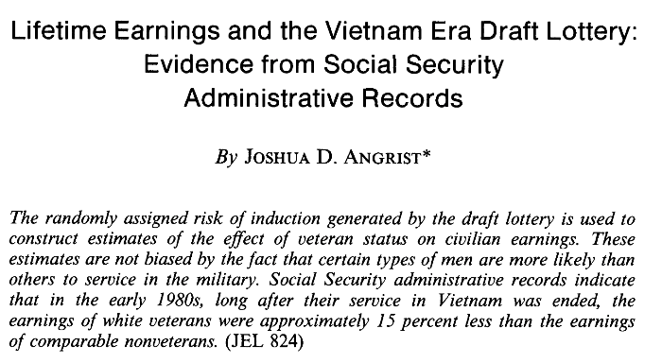

Slide 77
References
Chapter 8 of the textbook
Networks, Crowds, and Markets, David Easley and Jon Kleinberg
Networks: An Introduction, MEJ Newman
Statistical Analysis of Networked Data: Methods and Models, Erik D. Kolaczyk

Slide 78
Summary

